Slide 1


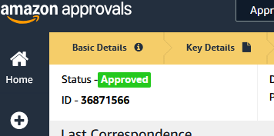
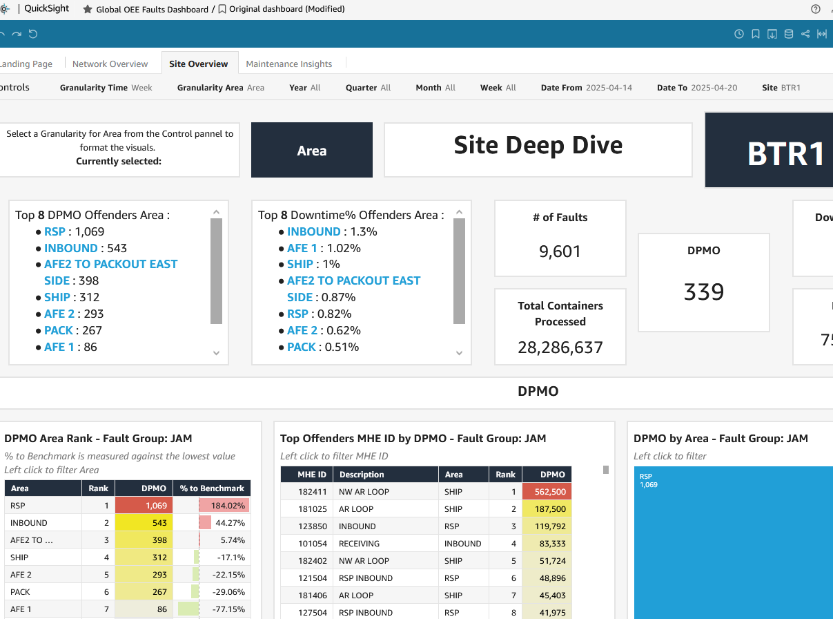
GLOBAL JAM PROGRAM
🚨 FLASH ALERT 🚨
📋 BREAKING NEWS: Global OEE Dashboard & Standards Update
EXPECTED MILESTONE REACH!
✨ Global OEE Dashboard Established as Official Network Standard
RME leadership endorses as official network standard the Global OEE and Global Faults Dashboard
WHAT THIS MEANS:
Effective immediately, the organization is implementing the Global OEE Dashboard as the network standardized platform for operational analytics. This enterprise-wide transition establishes a single source of truth for jam visibility, tracking, and performance reporting. The implementation aligns with Amazon’s commitment to data standardization and operational excellence across the network
WHATS NEXT?
⏰ Effectively immediately:
Use the Global OEE & Faults dashboard for all OEE & Jam performance reviews
Discontinue use of legacy tools or local dashboard for jam threshold tracking
Begin shifting your narratives and escalation to align with the new standardized thresholds
WHY THIS IS A BIG DEAL:
One global language
Say goodbye to inconsistent metrics
Faster escalations: Jam hotspots will now be easier to detect and resolve
Greater accountability: thresholds helps us track performance and impact in a standardized way
CELEBRATING PROGRESS & DRIVING CONTINUOS IMPROVEMENT!
This strategic initiative marks the foundation of our broader transformation agenda. Through the collaborative efforts of the C-RME and Field RME teams working together to correct any data discrepancies, we are implementing measurable, data-driven improvements across Amazon's global network. Customer support continues to be a critical priority, and your leadership and engagement remain essential to advancing our operational excellence worldwide
Thank you to everyone who supported the data validation and stakeholder alignment to make this happen
Resources
- OEE Global Dashboard
- Global OEE Faults Dashboard
Password: map-bi-prod
Questions? Feedback? Need Access?
Reach out to the global jam program team
drop a message in the Global-jam-program-support slack channel
Or message RME Central Map Team - Wiki
Driving Performance Excellence Through Reduced Disruption!
Project Owner: Global Jam Program Implementation Date: April 22 2025

